Slide 1
Presentation on “coordination committee for NSDI in Japan” Geospatial Infrastructure and Open Innovation
2016-11-09 JICA NSDI Seminar
/ 2016-11-14 SSGCC
Hidenori FUJIMURA
GSI International
Photo by Junkichi Egashira, llicensed under CC BY 4.0 International
Notes:
Hello. I would like to introduce the coordination committee for NSDI in Japan, but in addition I would like to introduce Geospatial Infrastructure and Open Innovation in Japan.

Slide 2

Geospatial Information Authority of Japan (GSI)
We’re Japan’s National Geospatial Information Authority
Notes:
I am from Geospatial Information Authority of Japan, or GSI. We are Japan’s National Geospatial Information Authority of Japan.

Slide 3

Hello
Director,
International Affairs Division, GSI
Head of Delegation,
Japan to ISO/TC 211
Leader,
ICT Advisory Team, GSI
github.com/hfu
facebook
Notes:
My name is Hidenori Fujimura, Director of International Affairs Division of the Geospatial Information Authority of Japan, or GSI. I am also the Leader of ICT advisory team of GSI because my background is ICT, and I am also in international standardization of geographic information. I act as the head of delegation from Japan to ISO/TC 211. I am also active in GitHub and Facebook for promoting the use of geospatial information from my organization.

Slide 4
Topics
coordination
ownership
involvement
Notes:
I would like to speak on the coordination work in this presentation, but I would also like to speak on ownership and involvement, too.

Slide 5
coordination
Notes:
Firstly I speak on coordination.

Slide 6
coordination
History of Japan’s coordination for NSDI
1 | 1995-01 | Great Kobe earthquake
2 | 1995-09 | Inter-ministerial committee on GIS
3 | 1996- | National Programs for GIS and NSDI
4 | 2002 | Revision of Survey Act, to adopt ITRF94 (≒WGS84)
5 | 2003 | GSI Maps (web maps by GSI) started
6 | 2007 | NSDI Act* enacted * Basic Act on the Advancement of Utilizing Geospatial Information （地理空間情報活用推進基本法）
7 | 2008/2012 | NSDI Basic Plan** 2008-2012 ** Basic Plan for the Advancement of Utilizing Geospatial Information （地理空間情報活用推進基本計画）
8 | 2011-03 | Great east Japan earthquake
9 | 2012/2016 | NSDI Basic Plan 2012-2016
10 | 2016/ | NSDI Basic Plan 2016- (in development)
Notes:
Coordination for NSDI in Japan is motivated by great earthquake disasters.
In 1995, there was a great earthquake in Kobe city, and the lack of the core geospatial data were recognized.
This initiated the inter-ministerial committee on GIS in the same year.
This committee has produced national programs for GIS and NSDI several times.
Based on the experience from these actions, NSDI Act has enacted in 2007.
According to this NSDI Act, we have two versions of NSDI Basic Plan decided by the Cabinet, and the third version is under development.

Slide 7
Structure of NSDI coordination based on NSDI Act
NSDI Act
Article 9: The national government shall develop a NSDI Basic Plan. The national government shall also review the Plan.
Article 10: The national government shall make institutional arrangements for the cooperation among related administrative organizations … for the development of NSDI Basic Plan and the implementation of policies based on the Plan.
NSDI Basic Plan
Cabinet decision
NSDI Steering Committee*
* Committee for
the Advancement of Utilizing Geospatial Information
Notes:
The basic structure of NSDI coordination in Japan is like this.
According to the Article 9 of the NSDI Act, the national government must develop and update the NSDI Plan.
According to the Article 10 of the NSDI Act, NSDI Steering Committee and related working groups are organized.
One of the main mission of the NSDI Steering Committee is to develop, review, and update the NSDI Basic Plan.

Slide 8
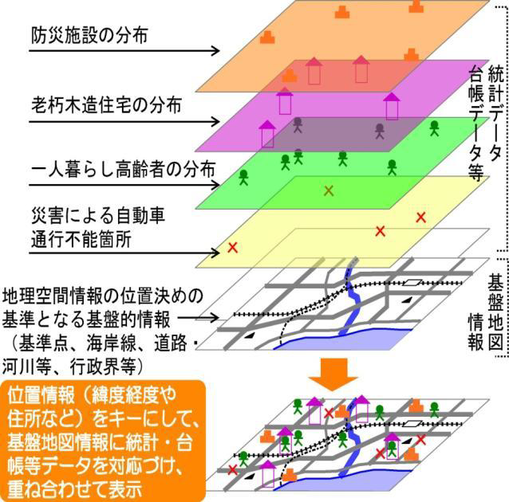
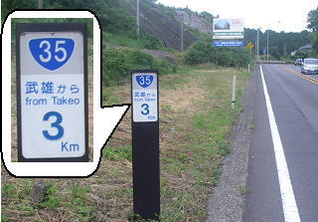
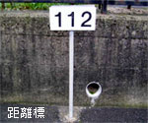




2 pillars of NSDI Act
Geospatial Information
Satellite Positioning
Fundamental Geospatial Data
Multi-GNSS Satellite Positioning
Disaster prevention facilities
Brittle houses
Collaboration
Residents who need supports
Blocked roads
Fundamental Geospatial Data
Combine
Integrate
Analyze
Promote comprehensive application measures
Notes:
There is 2 pillars of NSDI Act.
One is Geospatial Information. We provide Fundamental Geospatial Data, a framework geospatial data in 1 to 2 thousand and 5 hundred in urban area.
The other is Satellite Positioning. We promote satellite positioning, especially making use of our GNSS CORS infrastructure.

Slide 9
Coordination among different sectors
NSDI Act article 4 - 8
national government
responsibility
to develop and carry out comprehensive policies
legal and other measures
taking legal, financial, and other measures
enhancement of cooperation
taking necessary measures to enhance the liaison
local governments
responsibility
Developing and carrying out policies in harmony with the circumstances of their regions
cooperation
private sector
efforts
to provide high quality geospatial information
to cooperate with the national and/or local governments in their policies
academic
sector
research institutions such
as universities
Notes:
The articile 4 to 8 of the NSDI Act stipulates the responsibilities and cooperation of different sectors.
The national government has a responsibility to enhance cooperation among private, academic, and government sectors.

Slide 10
NSDI Steering Committee
Chair: Deputy chief cabinet secretary
(parliamentary and administration)
Acting: Assistant deputy chief cabinet secretary
Members: Bureau directors of relevant agencies
including director-general of GSI
Secretariat: Cabinet, MLIT* and GSI
* National and regional policy bureau, ministry of land, infrastructure, transport and tourism
NSDI steering committee*
* Committee for
the advancement of Utilizing Geospatial Information
Geographic information systems WG
Satellite positioning WG
Geospatial project promotion WG
Review Teams
Promotion Teams
RT on protecting personal information and intellectual property
RT on national security
RT on development and update of fundamental geospatial gata
PT for utilization of geospatial information center
PT for advancement of disaster prevention system
PT for IT-based agriculture, forestry and fisheries
PT for vitalization of communities and small and mid-size enterprises
PT for overseas development
Notes:
The NSDI steering committee of Japan is chaired by deputy chief cabinet secretary. The director general of GSI is a member of the committee, and GSI acts as one of the secretariat member of the committee.
Under the steering committee, we have working group on geographic information systems, satellite positioning, and project promotion. There are several review teams and promotion teams under the working groups.

Slide 11
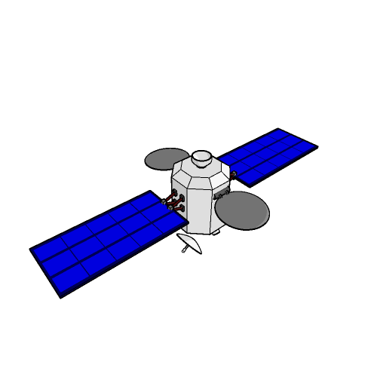
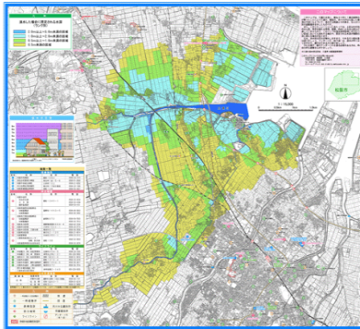



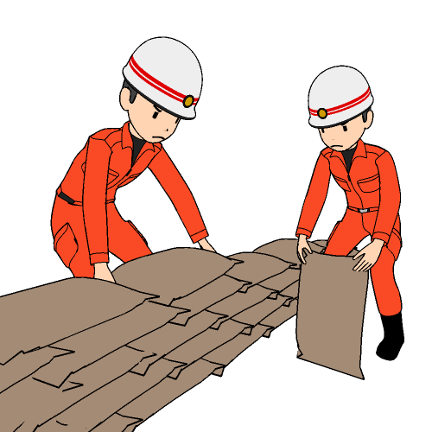

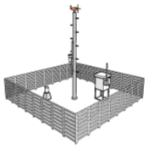



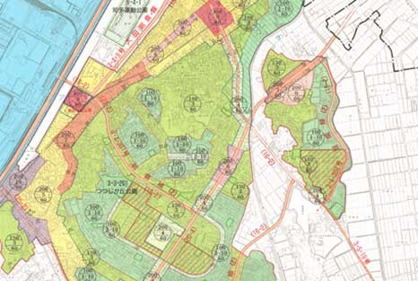




NSDI Basic Plan 2012-2016 – basic guidelines
Approaches for realizing the Geospatial Society
sustainable and disaster-resilient land use
high-quality, safe, and secure living
new services and industries
greater efficiency and quality of govt. services
Notes:
Let’s get down to the NSDI basic plan. The current basic plan is the approach for realizing geospatial society, where sustainable and disaster resilient land use, high-quality, safe and secure living, new services and industries, and greater efficiency and quality of government services, are realized.

Slide 12
NSDI Basic Plan 2012-2016 – goals and measures
Goal #1
on geographic information system
Goal #2
on satellite positioning, navigation and timing
Goal #4
on sustainable and resilient land use
developing seamless geospatial information to meet society’s needs and applications to new uses
development and utilization of quasi-zenith satellite systems (QZSS) inside and outside Japan
recovery from the Great east Japan earthquake and contribution to sustainable and disaster-resilient
land-use
Goal #3 for penetration in society
Further penetration and establishment
of the geospatial information in society
Specific measures towards the Geospatial Society
This concludes the introduction of the coordination committee for NSDI in Japan.
Notes:
In order to do so, the basic plan has four goals. Under these goals, specific measures by the relevant government organizations are allocated.

Slide 13
ownership
of specific measures
Notes:
Next, I would like to shortly talk about the ownership of specific measures.

Slide 14
ownership
GSI broke down our contribution to NSDI into 3 components.
ownership and involvement matters, to implement NSDI.
NSDI
National Spatial Data Infrastructure
Geospatial Society
Various application by open innovation
Disaster Response as the Moment of Truth
(1) GNSS CORS Infrastructure
(2) Institutional Arrangement
(3) Web Maps
Geospatial Infrastructure
Open data service, often by open source software
These are what we take ownership for Geospatial Society.
Notes:
As a national geospatial information authority, GSI has been thinking about how we can contribute to NSDI.
Our conclusion is that we are to provide Geospatial Infrastructure. The main component of our Geospatial Infrastructure is GNSS CORS infrastructure, institutional arrangements, and web maps. In addition, we think that the disaster response is a kind of Moment of Truth, when we get a time to face the direct demand from the society.
These are what we take ownership for Geospatial Society.

Slide 15
involvement
of more partners to promote innovation
Notes:
Next and the last, I would like to talk about the involvement of more partners to promote geospatial innovation.

Slide 16
involvement
We try involve more partners by:
Open Data
We follow the Open Data Policy of the Government of Japan (compatible with CC-BY)
In addition, Survey Act applies to core data.
Open Source
We use Open Source for (1) lowering running cost and for (2) promoting development of domain-specific applications.
We also develop open source software available at GitHub.
Open Innovation
We run a community of geospatial developers who use our data – GSI Maps Partner Network.
We participate in existing community events such as FOSS4G Tokyo/Kansai, Code for Japan Summit, and GitHub Universe.
Notes:
We are trying to involve more partners by Open Data, Open Source, and Open Innovation.
Open Data is a policy of the Government of Japan.
And we use and develop open source software for lowering the running cost and for promoting development of domain specific applications.
We also run a community to promote innovation.

Slide 17
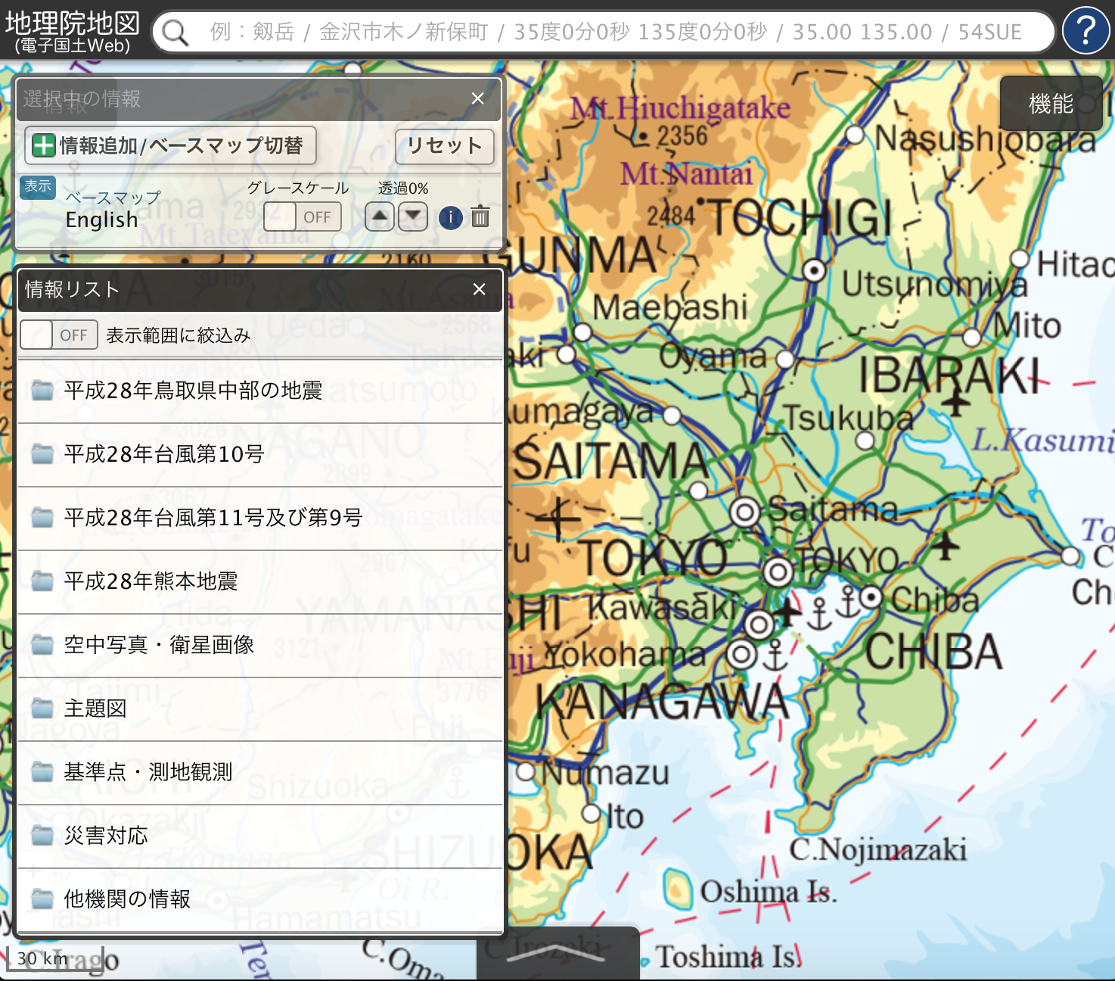
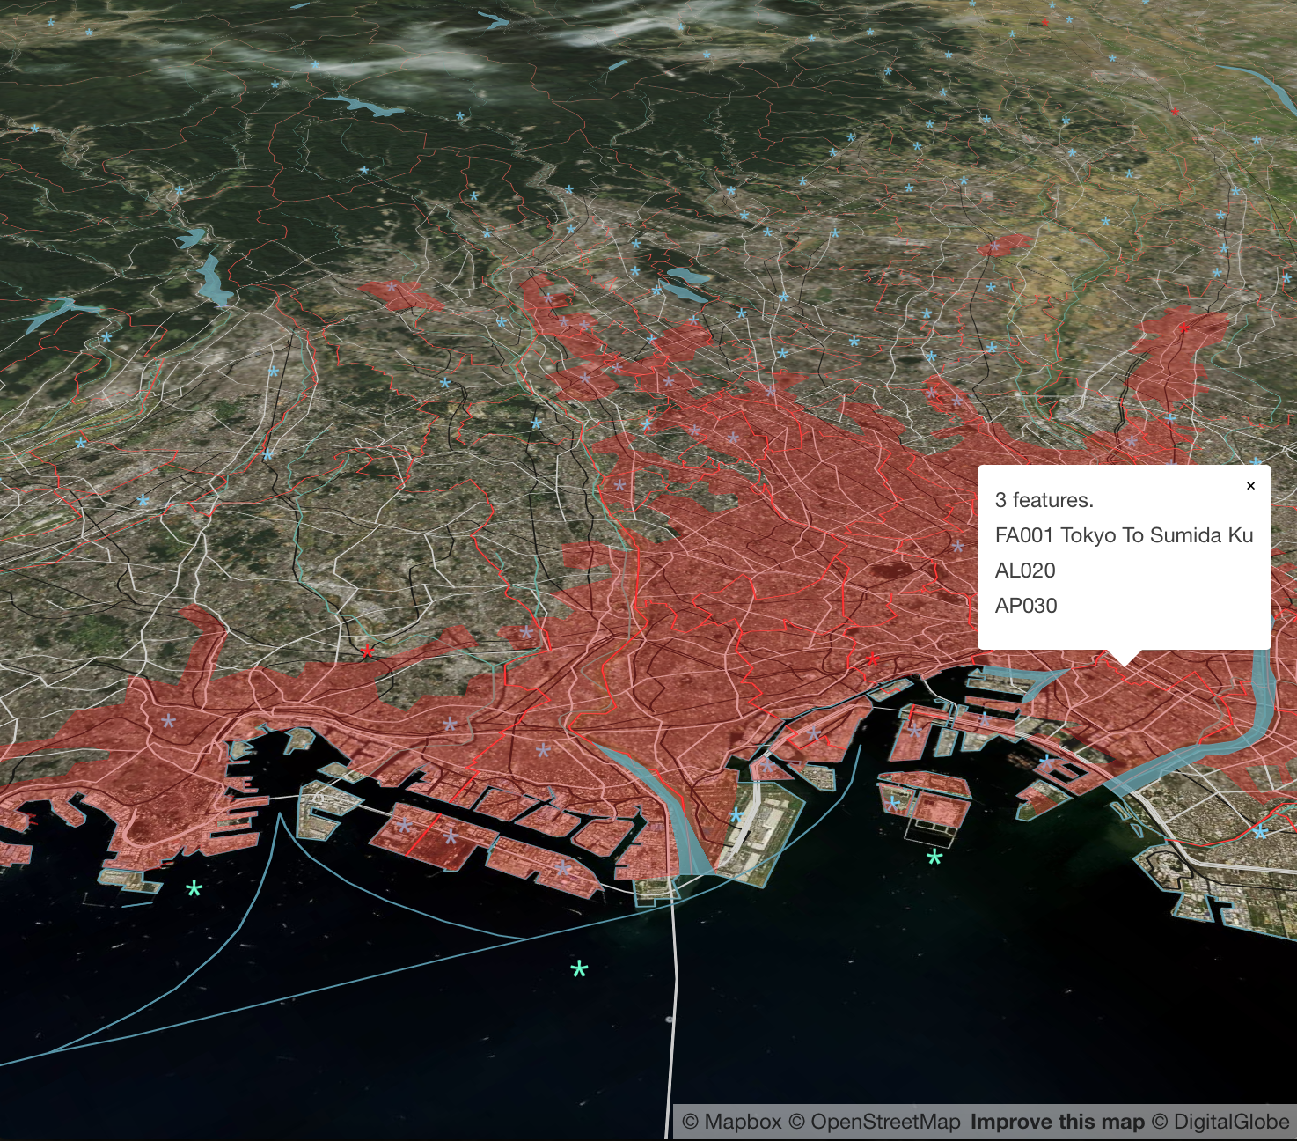
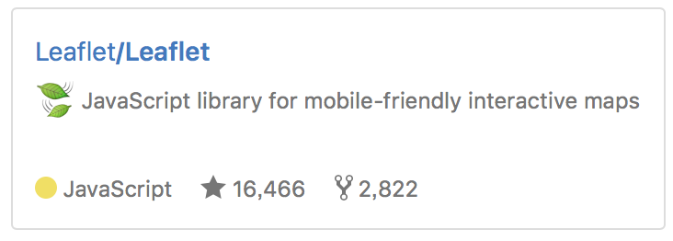


We import great open source software developed also in Ukraine
http://maps.gsi.go.jp/
Our geoportal “GSI Maps” provides approximately 1,600 layers as tiles or GeoJSON files.
http://bit.ly/tokyo-vt
Global Map data in binary vector tiles, to promote wider application (in development.)
uses
uses
Notes:
We actually import Open Source Software developed in Kyiv, Ukraine.
Our GSI Maps uses Leaflet. And our Global Map binary vector tiles uses Mapbox GL JS.
Both of these software are heavily developed by a software engineer Mr Vladimir Agafonkin who lives in Kyiv.

Slide 18
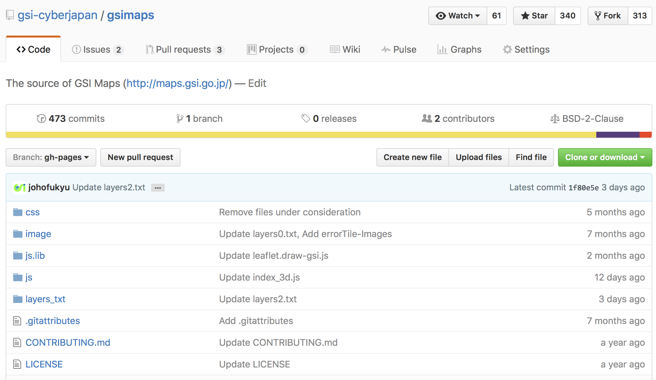
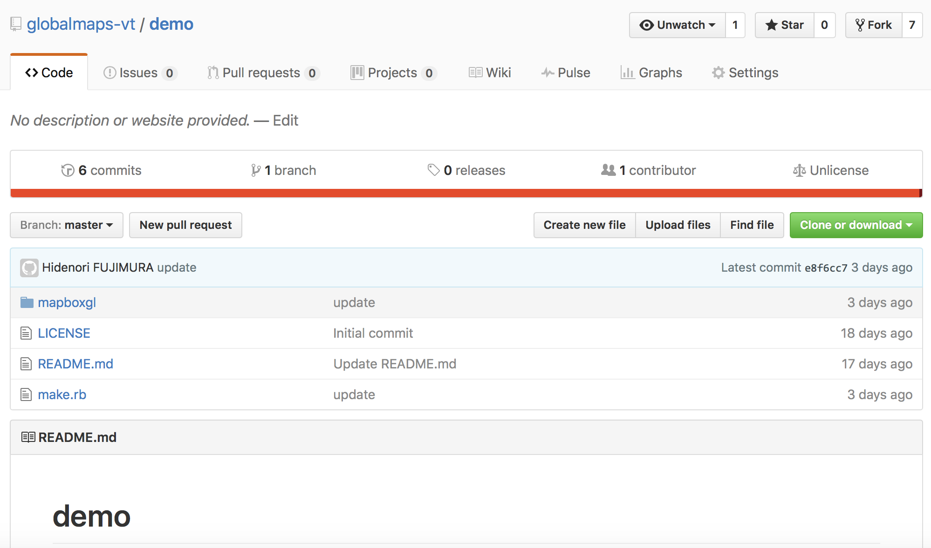
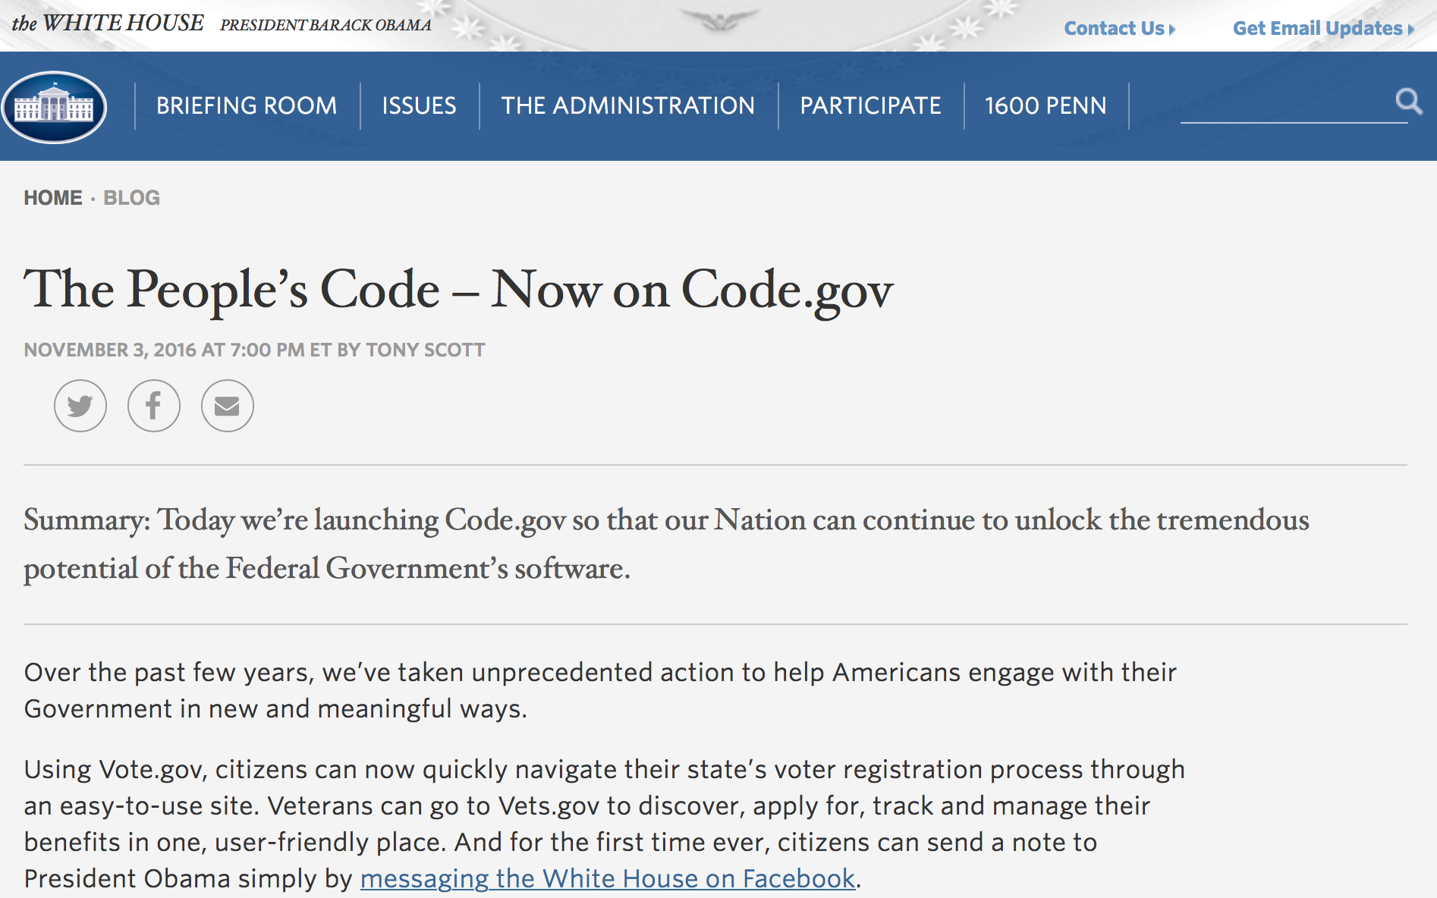
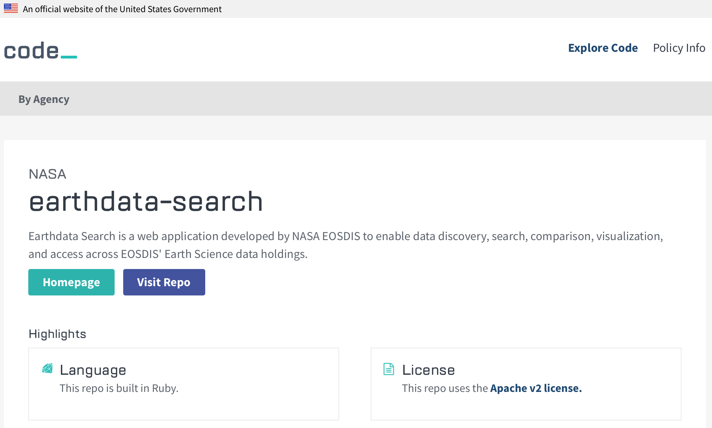
We share our code
https://github.com/gsi-cyberjapan/gsimaps
https://github.com/globalmaps-vt/demo
Notes:
We also share our code developed by us. You can have a copy of our code for GSI Maps and Global Map binary vector tiles.
By the way, this is very similar to what code dot gov are doing in the United States government.

Slide 19
Summary
coordination
ownership
involvement
are all important.
Let’s involve everyone and each other, in order to catch up with changing technology trend, for wider and better application of our geospatial information.
Notes:
In summary, we think that coordination, ownership, and involvement are all important.
So Let’s involve everyone and each other, for wider and better application of our geospatial information.
thank you very much.

